Slide 1
Residential Water Consumption in Los Angeles:
What are the Drivers and are Conservation Measures Working?
KRISTEN HOLDSWORTH & CELINE KUKLOWSKY
SOUTHERN CALIFORNIA WATER DIALOGUE - JULY 23, 2014
DISSERTATION BY: Caroline Mini
PRINCIPAL INVESTIGATORS: Stephanie Pincetl and Terri Hogue
GRANT: NSF ULTRA-EX Program
Notes:
KRISTEN

Slide 2
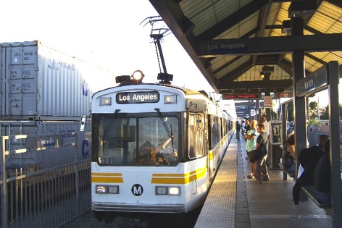
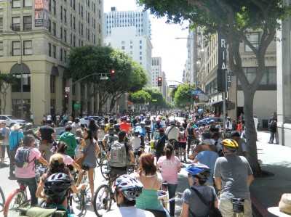
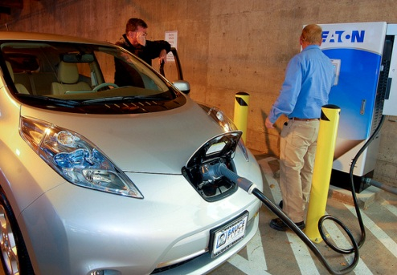
ABOUT THE CCSC
The California Center for Sustainable Communities (CCSC) is a statewide collaboration that brings together leading-edge researchers to inform California’s transition toward urban sustainability
CCSC provides resources for policy makers, stakeholders and the residents of the state. Our mission is to assist the state’s communities in the transition to greater sustainability on multiple fronts
CCSC’s expertise is in integrated energy analysis. We partner with utilities, cities, counties and others to provide rigorous research that informs decision-making and improves communities
Notes:
KRISTEN

Slide 3


CCSC AT UCLA RESEARCH TEAM
Notes:
KRISTEN

Slide 4
PROJECT BACKGROUND
Dr. Caroline Mini, PhD Dissertation of residential water consumption patterns and drivers in LA County
Ten years of data that links water consumption with socio-economic demographics, climate information, and water prices.
Three studies:
  Drivers of single-family residential water use
  Outdoor water consumption and drivers
  Effectiveness of 2007-2009 water conservation programs for LADWP territory
Policy analysis, recommendations, and brief written by CCSC at UCLA
Notes:
KRISTEN

Slide 5
DRIVERS OF SFR WATER USE
Single-family residential water consumption in Los Angeles primarily driven by:
  Income
  Landscape greenness
  Water rates
  Household water volume allocation
LADWP territory, the average SFR water consumption ranges:
37.4 HCF/SFR customer/yr - 1,214 HCF/SFR customer/year
Geographical clusters of water consumption: northern, coastal, downtown
Notes:
CELINE

Slide 6
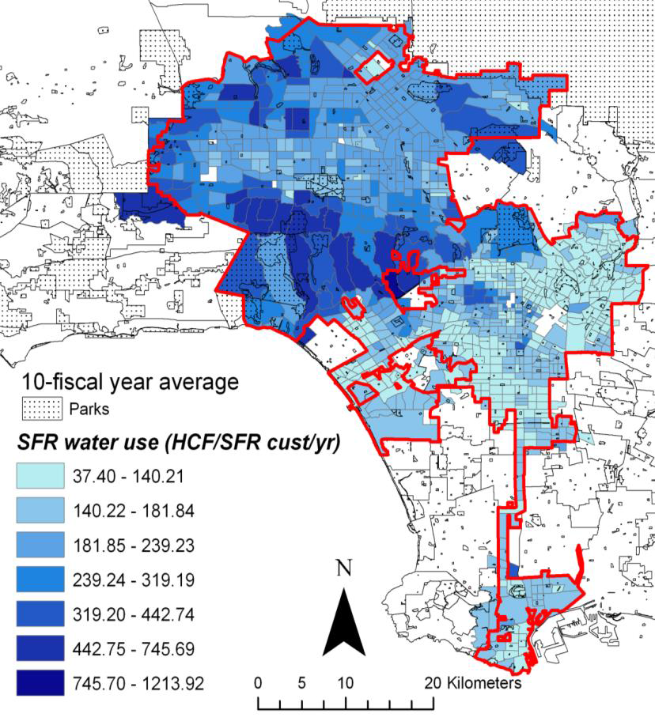

10 YEAR AVERAGE SFR WATER USE PER CENSUS TRACT
Notes:
CELINE
Add in details about clusters/neighborhood characteristics
Clusters based on physical characteristics- climate, precipitation, vegetation/landscaping, lot size, neighborhood density

Slide 7
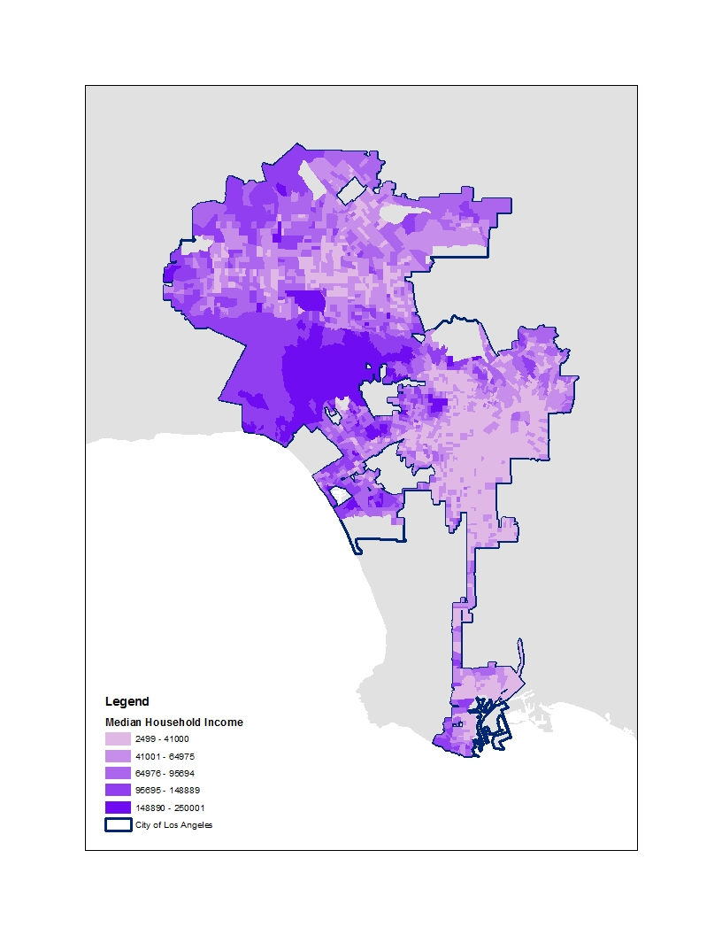
Water Consumption
Income
Map from: Mini, C., T.S. Hogue, and S. Pincetl, 2014: Patterns and Controlling Factors of Residential Water Use in Los Angeles, California, Water Policy, doi:10.2166/wp.2014.029
Notes:
CELINE

Slide 8
INCOME AS PRIMARY DRIVER
Wealthier neighborhoods consume three times the amount of water than less affluent neighborhoods
  Pacific Palisades (827 m³/SFR customer/yr)
  Downtown LA (369 m³/SFR customer/yr)
  Playa Vista and Venice are exceptions (dense coastal)
Income and household characteristics are tightly connected
  Lot size, gardens, parcel and building characteristics
$1,000 increase in median household income increases SFR water use by about 2%
Notes:
CELINE
Playa Vista was developed later, with sustainable building practices in mind so we would expect lower water consumption here
Check if it’s 10 year average or annual average for PACIFIC PALISADES

Slide 9
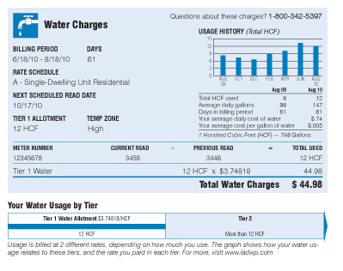
TIER WATER RATES AND HOUSEHOLD ALLOCATION
The rate and household allocation of water also influence SFR water consumption
LADWP two-tiered rate system
  Allotments set by zip code, lot size, season and temperature zone
Notes:
KRISTEN
Residential water prices set at lower rate based on lower water allotment (Tier 1) and second higher rate (Tier 2) for every additional billing unit (1 HCF)
Water income decreases for all households regardless of income, neighborhood, or water use level

Slide 10
TIER WATER RATES
When water rates increase, water consumption for all households decreases
Greater responses to increases in Tier 1 rates than in Tier 2 rates:
  If Tier 1 rates were to increase by 10%, water demand would decrease by 2% for Tier 1 and 0.7% for Tier 2.
  Lower income customers more sensitive to changes in Tier 2 than higher income customers.
Tier 2 rates not triggering their intended savings and are disproportionately affecting lower-income groups.
Notes:
KRISTEN
SFR households across all income and water use groups respond more to increases in Tier 1 rates than in Tier 2 rates

Slide 11
HOUSEHOLD WATER ALLOCATION
When water volume allocation is increased, SFR water consumption rises
Increase in household volume allocation of 10 HCF (30% average increase) results in SFR water use increase of 9%
Low water users are more sensitive to increases in volume allocation
Neither price nor volume are sufficiently targeting higher water users
Notes:
KRISTEN
Two tier system may need to be revised as a result to target higher users

Slide 12
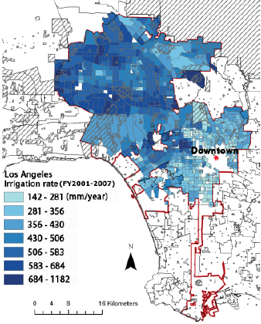
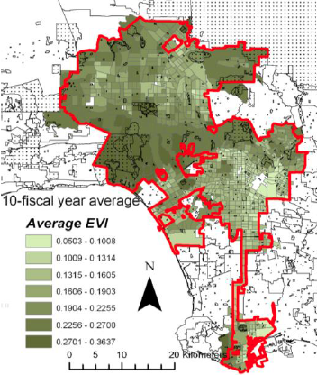
Outdoor Landscaping Irrigation
Green Index
Income
Maps from: Mini, C., T.S. Hogue, S. Pincetl, 2014: Estimation of Residential Outdoor Water Use in Los Angeles, California, Landscape and Urban Planning, 127, 124-135
Notes:
CELINE
Outdoor vegetation is another important driver in SFR water use. Greenness primarily driven by outdoor water use (precipitation only accounts for a small percentage of variations in greenness)
Green index: existence (or not) of outdoor landscape (follow up/read discuss “greenness”)
Income is strongly correlated with outdoor irrigation volumes and landscape greenness
Green index is Spatially clustered patterns with outdoor irrigation and greenness can also be explained by climate zones, types of trees and grass cover
Outdoor irrigation greater in warmer parts
Outdoor irrigation lower in denser parts

Slide 13
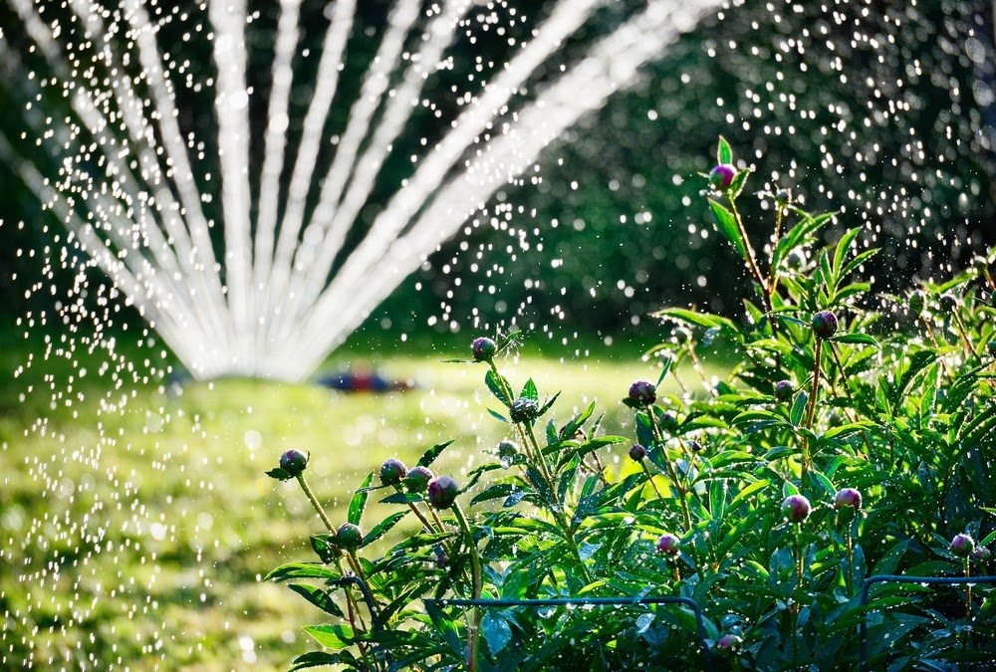
OUTDOOR WATER CONSUMPTION IN LA
Challenge: distinguishing indoor vs. outdoor water use
Outdoor water use accounts for 54% of overall SFR water consumption
Notes:
CELINE
Outdoor vegetation is another important driver in SFR water use. Greenness primarily driven by outdoor water use (precipitation only accounts for a small percentage of variations in greenness)
We don’t have dual meters,
Model for the 54% estimate comes from applying NDVI values to the census tract
DROUGHT connection

Slide 14
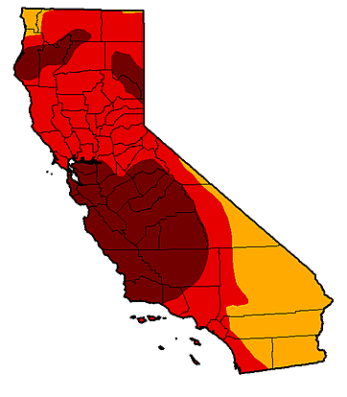

CONSERVATION MEASURES
Notes:
KRISTEN

Slide 15
2007-2009 LADWP WATER RESTRICTIONS
Year | Type of Restriction | Details
2007 | Voluntary | Voluntary conservation called for by the mayor
2008 | Mandatory (Phase I) | Limitations on: Daytime watering Frequency and duration of outdoor irrigation depending on irrigation technique Water waste practices
2009 | Mandatory (Phase III) + Pricing | Previous 2008 limitations PLUS: Only two days of watering allowed/week Pool and spa restrictions No washing of vehicles in streets Increased reductions in watering times and frequency Decrease in SFR allocation by 15% Increase in Tier II rate by 44%
Notes:
KRISTEN
We studied the impact of these various programs on Single-Family Residential water use, both on indoor and outdoor use, to evaluate the effectiveness of these measures and assess the change in consumption by temperature zone, income range and lot size category at the same regional spatial scale.

Slide 16


EFFECTIVENESS OF 2007-2009 WATER RESTRICTIONS
Water Savings
6%
23%
Voluntary Restrictions
Mandatory Restrictions and Pricing
Notes:
KRISTEN
Mandatory restrictions are more effective at reducing water consumption for SFR households than voluntary measures.
the greatest impact of measures resulted from the combination of mandatory watering restrictions and the price increase. This led to the highest water reduction of 23% in July/August 2009. This suggests the potential for long-term and durable reductions, particularly in outdoor use, should these measures be sustained over time.

Slide 17
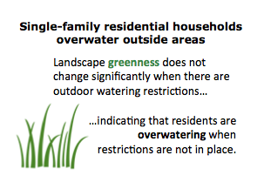
RESTRICTIONS AND OUTDOOR WATER USE
Stringent mandatory restrictions of June 2009 led to around 35% reduction in outdoor irrigation rates.
Notes:
KRISTEN
35% reduction relative to 2001-2007 period
Considering landscaping irrigation use represents on average 54% of total Single-Family water use, this represents a dramatic reduction in use, and demonstrates the effectiveness of mandatory water restrictions—which includes the 2-day/week irrigation limit, the water rate increase and decrease in water allotment—in reducing landscape irrigation.
despite these restrictions, Los Angeles generally maintained the same level of greenness, with EVI values remaining stable. This suggests that vegetation may be over-watered and that there is still room for outdoor water conservation.

Slide 18
SUMMARY OF WATER RESTRICTION FINDINGS
    2009 Restrictions: Reductions across all neighborhoods
    Annual single-family water use decreased by:
      17% in Pacific Palisades
      11% for Florence (2008-2010)
    Low-water users reduce consumption more than higher water users when rates increase
  2007 and 2008 restrictions: Lower income groups conserved more than higher income groups
  Mandatory restrictions are more effective at targeting higher income users (as opposed to voluntary measures)
Notes:
KRISTEN
Lower income groups responded more to the voluntary and mandatory reduction policies of 2007 and 2008 compared to higher income groups (from 12% to -4% respetively)
These are particularly noteworthy findings as higher income users and warmer parts of the city tend, overall, to have higher water use levels, as demonstrated in the previous section. This points to a potential margin for reducing consumption particularly at the higher income and higher use levels.

Slide 19
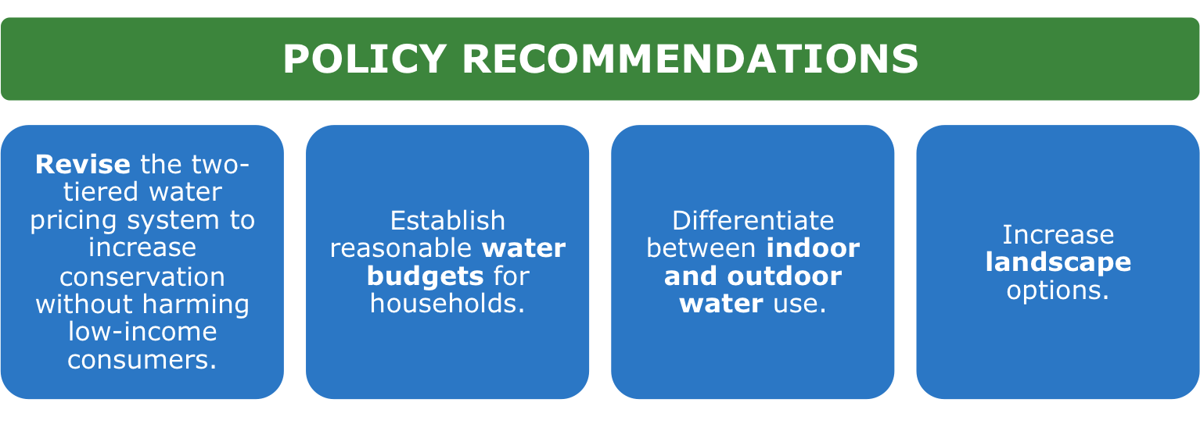
Notes:
CELINE

Slide 20
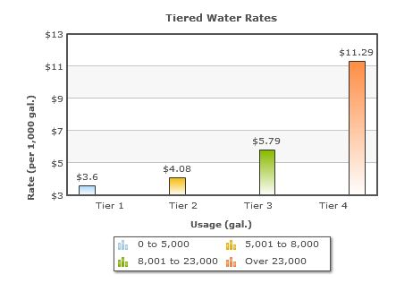
Notes:
CELINE
Revise the two-tiered water pricing system to increase conservation without harming lowincome consumers. Possible alternatives:
• An increasing block rate structure with more than two-tiers, in which the unit price for water rises as the volume of water consumption increases.
• Combine an increasing block rate structure with a seasonal rate structure, in which prices increase during summer months (to curb demand in high demand months).
Establish reasonable water budgets for households
• By establishing individualize water budgets based on location and household characteristics, those who consume above their allocated amount of water see an increase in their bill.
• Budgets can be applied separately for indoor and outdoor water use
• This kind of system takes into account the variations that exist across household water uses, and could greatly benefit lower use and lower income groups in Los Angeles.
Differentiate between indoor and outdoor water use
• The greatest water savings can be made in outdoor irrigation reduction, which represents the largest percent of single family residential water use
• Install dual-metering systems to bill outdoor use separately from indoor use and retrofit existing single-family residences
Increase landscape options
• Provide incentives and education on more efficient landscaping and irrigation options

Slide 21
Indoor Water Budget
Outdoor Water Budget
Water Budget
X gallons of water per person, per day
The number of people in the household
The number of days in the billing cycle
Amount of irrigated acreage per parcel
Daily evapotranspiration
Plant Factor
Notes:
CELINE
Establish reasonable water budgets for households
• By establishing individualize water budgets based on location and household characteristics, those who consume above their allocated amount of water see an increase in their bill.
• Budgets can be applied separately for indoor and outdoor water use
• This kind of system takes into account the variations that exist across household water uses, and could greatly benefit lower use and lower income groups in Los Angeles.

Slide 22

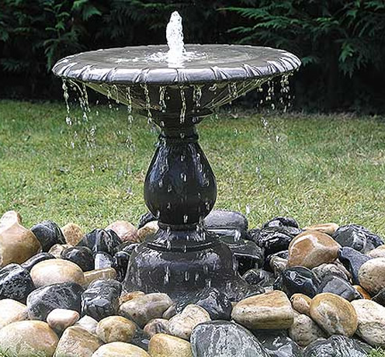
Notes:
Differentiate between indoor and outdoor water use
• The greatest water savings can be made in outdoor irrigation reduction, which represents the largest percent of single family residential water use
• Install dual-metering systems to bill outdoor use separately from indoor use and retrofit existing single-family residences
Increase landscape options
• Provide incentives and education on more efficient landscaping and irrigation options

Slide 23
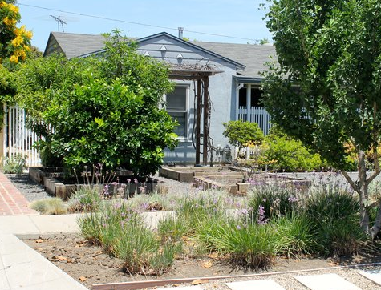
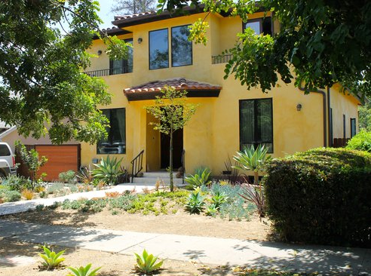
Notes:
Increase landscape options
• Provide incentives and education on more efficient landscaping and irrigation options

Slide 24
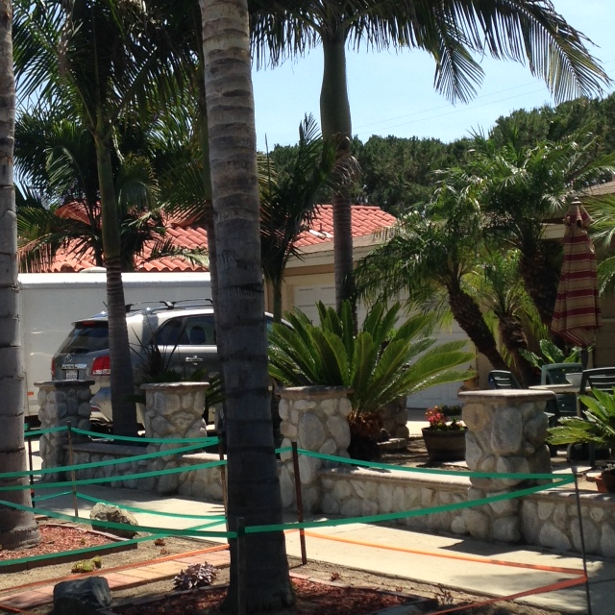
Notes:
Be Water Wise, landscaping options…

Slide 25
Notes:
But only if we’re replacing with the right landscape!

Slide 26
CONTACT US
Kristen Holdsworth kholdsworth@ioes.ucla.edu
Celine Kuklowsky ckuklowsky@ioes.ucla.edu
California Center for Sustainable Communities at UCLA
Institute of the Environment and Sustainability
Website: californiasustainablecommunities.com
Email: info@californiasustainablecommunities.com
Phone: (310) 825-3778

